Slide 1
Entity Framework database first
Nook

Slide 2
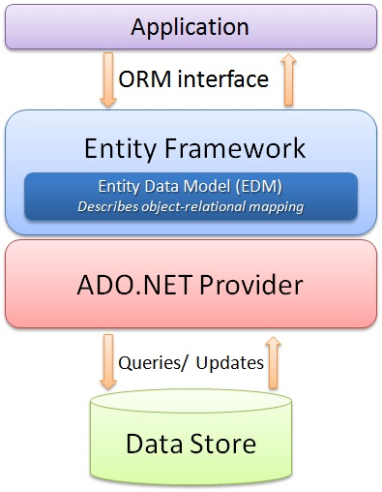
Intro
http://resource.thaicreate.com/upload/tutorial/entity-framework-introduction-01.jpg?v=1001

Slide 3
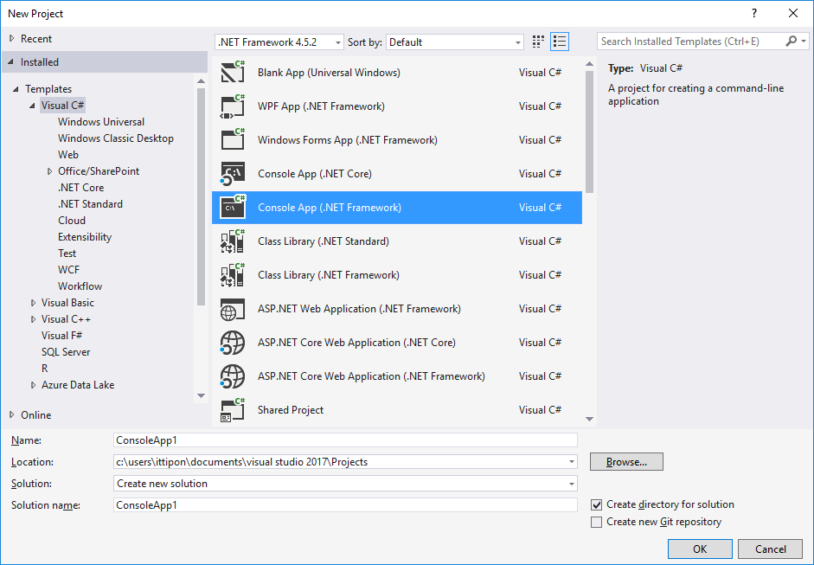
Create C# Project

Slide 4
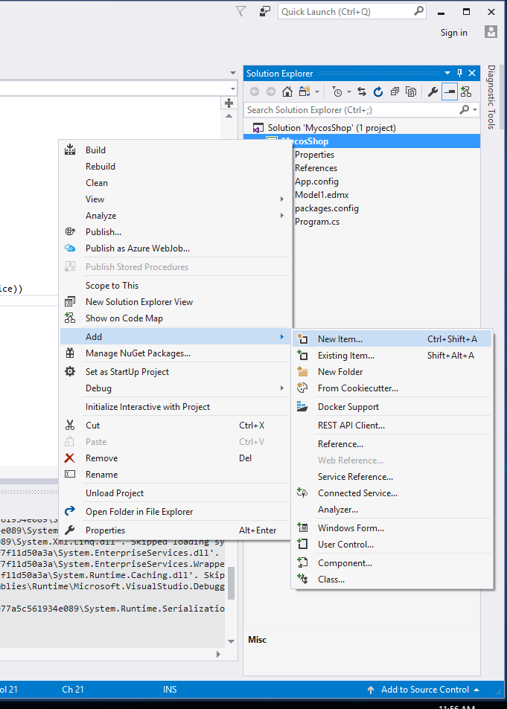
Add Entity Framework
Click Project In Solution Exploder
Choose Add then select New Item...

Slide 5
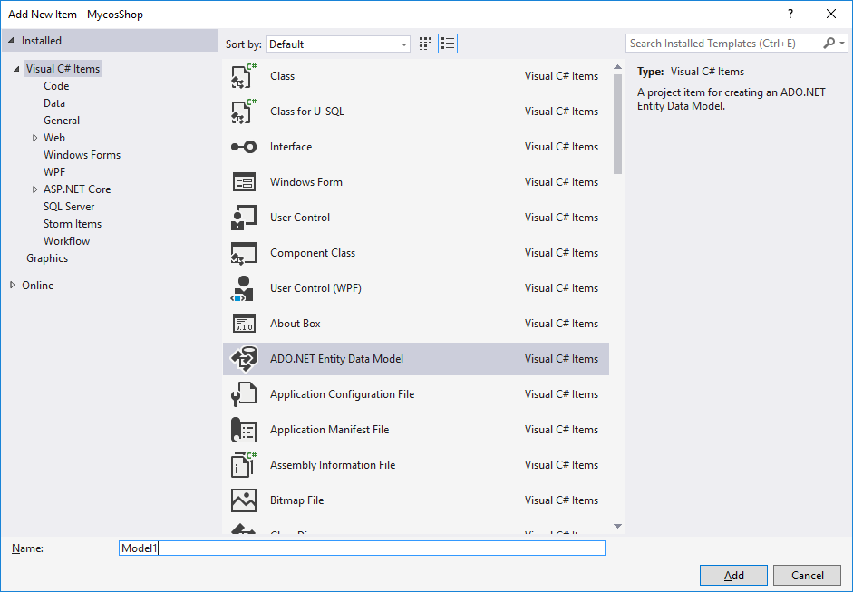
ADO. NET Entity Data Model

Slide 6
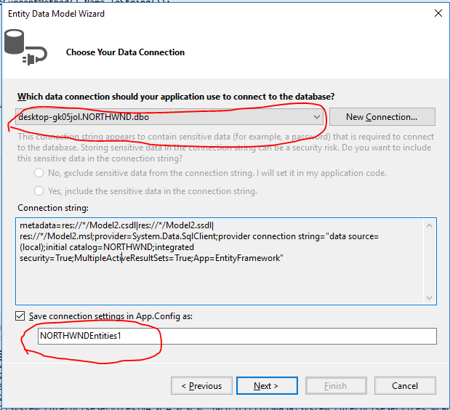
Config Connection String
Connection to Server
Name of connection to use this.

Slide 7
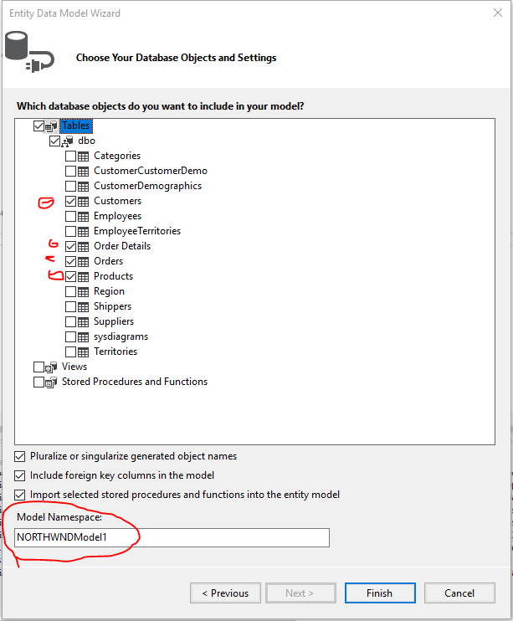
Select Tables to use.
Customers
Order Details
Orders
Products
Model Name to use this database

Slide 8
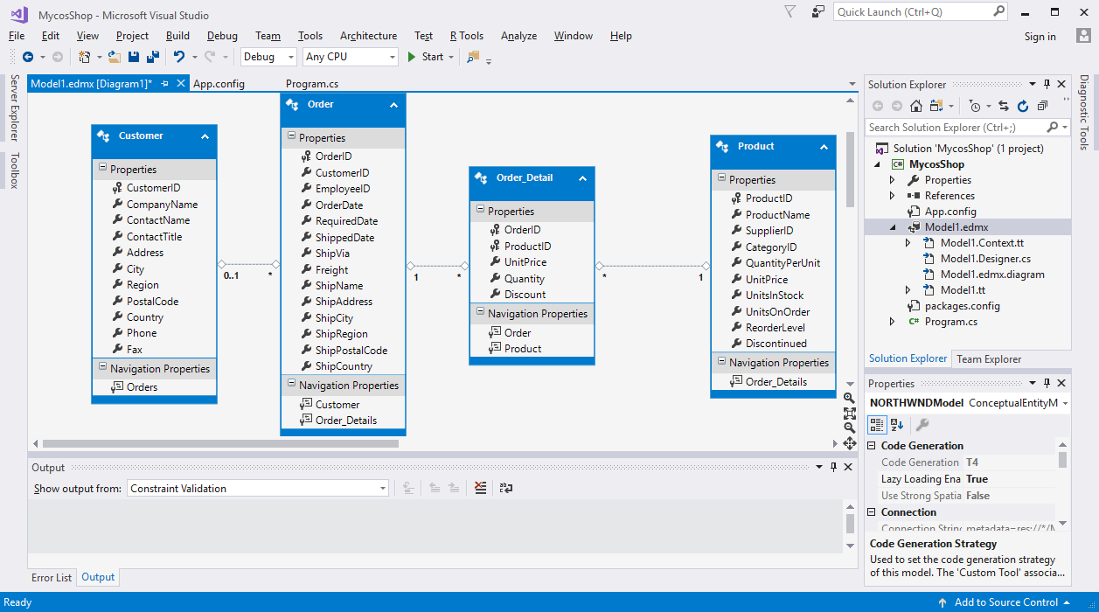
Model for database
Our classroom rules help us get along with each other:
Be respectful and responsible.
Be organized and follow directions.
Be on time.
Be prepared.

Slide 9
Class Subjects
Reading and Writing
Math
Science and Technology
Social Studies
Music and Art

Slide 10
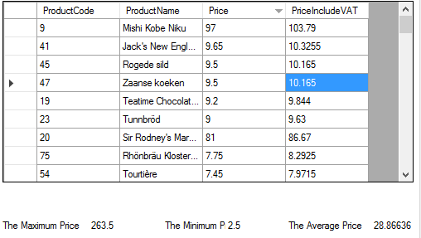
Assignment (con.)
Using NORTWIND Database to query.
In this assignment query from Product table.
1.) What LINQ ?
What SQL ?
2) Max Price
3) Min Price
4) Average Price
** send with stored procedure file name “sp_select_product.sql”

Slide 11
Reading
Briefly list the reading topics and activities
How about a book list?

Slide 12
Writing
Briefly list the writing topics and activities

Slide 13
Math
Briefly list the math topics and activities

Slide 14
Science and Technology
Briefly list the science and technology topics and activities

Slide 15
Social Studies
Briefly list the topics and activities
How about special projects?

Slide 16
Music and Art
Briefly list the topics and activities

Slide 17
Homework
45 minutes of homework every night.
Due on Friday morning
Need extra time? Go to homework club during recess.

Slide 18
Field Trips
We have lots of fun field trips planned for this year!
Attend two plays at the Children’s Theater (Reading units)
Take water samples from river at Maple Grove park (Science unit)
Tour a bakery (Social Studies unit)

Slide 19
Tardiness
School starts at 8:15 A.M.
Running late? Check in at the school office before coming to class.
If you are tardy four times, the school will contact your parents.

Slide 20
Supplies
Bring these items each day
Don’t bring these items
Number 2 pencil
Electronic devices

Slide 21
Resources
Library
Computer Lab
Teacher’s Aide
Parent Volunteers

Slide 22
Questions?

Slide 23
Let’s Have a Great Year!

